Slide 1
Medcurity Network Inventory
CS10: Medcurity Network Inventory Team
Brandon Huyck
Colleen Lemak
Artis Nateephaisan
Jack Nealon

Slide 2
Project Overview
Project Purpose:
  Facilitate risk assessment for medical offices (keep patient data secure)
  Software and device inventory is first step
  Required by HIPAA
  Goal is to generate through automation
Tasks for Tool:
  Scan the network
  Store the data
  Display to user, and allow updates
  Export to Excel for accessibility
Notes:
[Brandon]
Goal: sponsor provides risk assessment for medical offices to help keep patient data secure; inventory is helpful in assessment and required by HIPAA; we develop a tool to automate the generation of this inventory.
Tasks: Scan the network; store the data; display to user and allow updates; export to excel for ease of accessibility (important to sponsor)

Slide 3
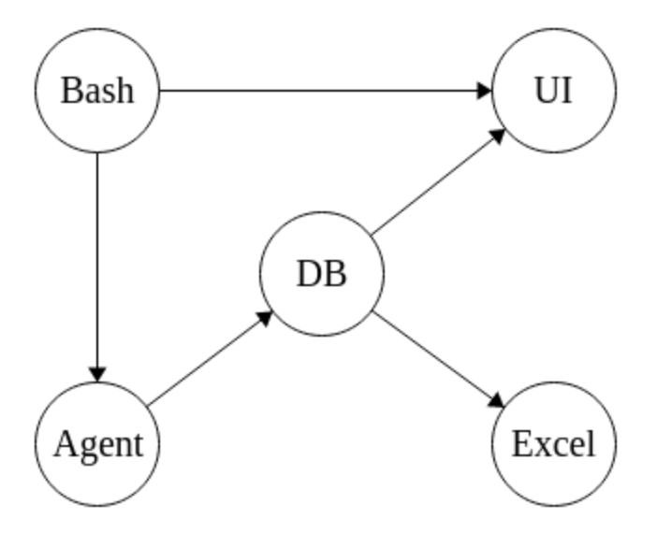
Project Block Diagram
Notes:
[Brandon] “Major Components”: Launch with bash, scan network, store info in db, display on ui, updatable through ui, export to excel with python

Slide 4
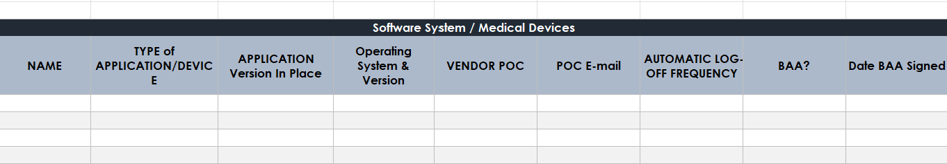
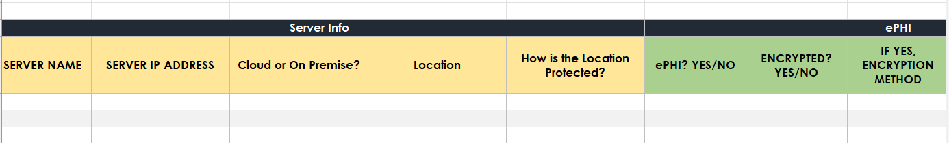
Inventory Example
Notes:
[Brandon] “Major Components”: Launch with bash, scan network, store info in db, display on ui, updatable through ui, export to excel with python

Slide 5
Work Accomplished Since Last Presentation
Crawler:
  Python3 libraries, Nmap, ARP Scanning
  Server Gateway IP, Location, Subnet, Encryption (if applicable)
  Device IP, MAC, type, OS name & version
  Ports, status, service & version
Database:
  Relations, tables, primary/foreign keys, efficient execution
User-Interface:
  Initial UI with navigation for login, home, settings pages
Notes:
If you can, show a live demo of the project working here or at the later slide on it - it'll depend upon how you want to move through the presentation
Discuss any progress made here
New pieces working, major changes needed
What have learned about the components/tools?

Slide 6
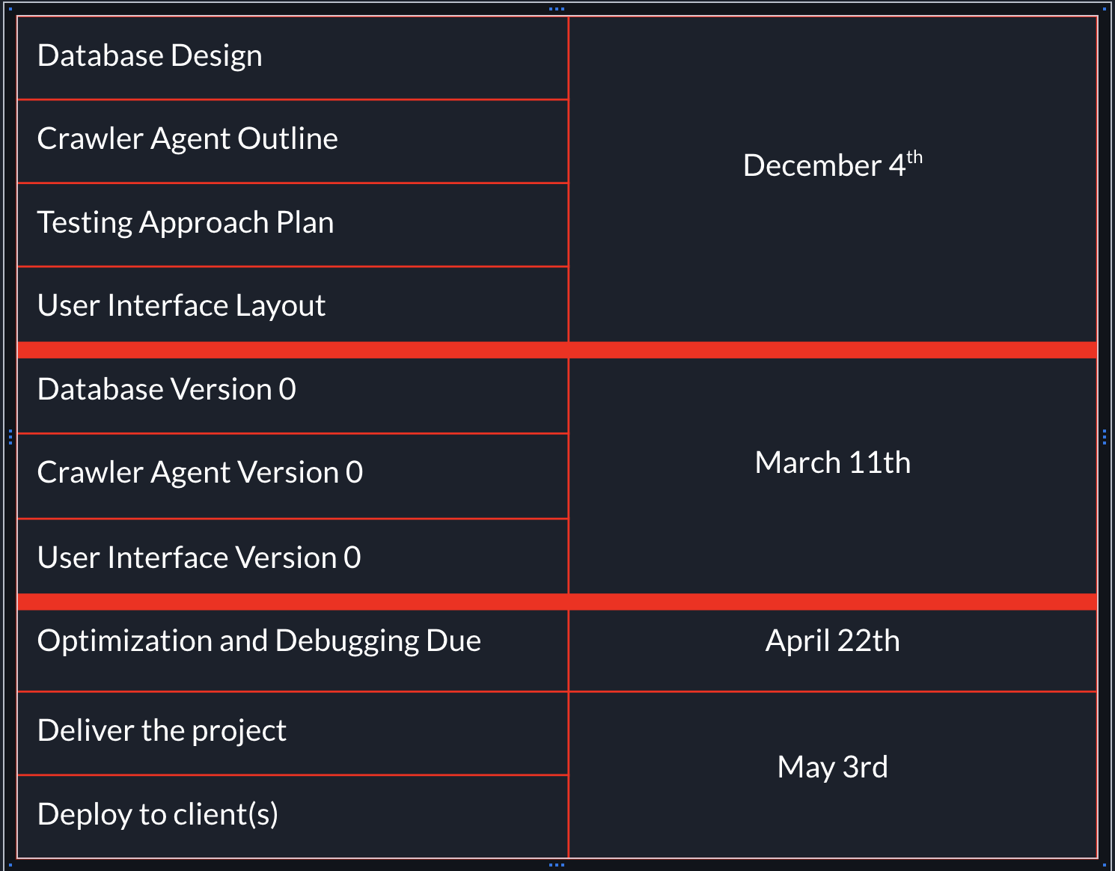
Comparative Timeline (Artis)
Show your timeline from the plan and compare it to actual progress
Progressing well
  DB Design, Crawler Outline, UI Layout completed within first couple of weeks
  DB, Crawler, and UI are all nearly complete, just need to add connectivity
Going to work on completing the components, pursue optimization, debugging, documentation, testing

Slide 7
Project Management Considerations
and Team Collaboration Approaches (Artis)
What approaches has your team agreed to use for running the project
  Two weekly meetings: one with advisor, DAB member, sponsors as needed, one with just the development team
  Pull requests are created and we typically assign at least one other team member to review and approve the request and merge
  Every sprint (2 weeks) we have a different team member lead the meeting and go through our backlog to get progress updates and assign backlog tasks as needed
Let us know how your team will be collaborating to make this happen
  Communicated through texts and Discord messages
  Mainly coded separately but brought up issues and during meetings and got them promptly resolved

Slide 8
Budget Plan and Status (Artis)
Does your project plan require budget resources?
  The main component that would require a budget was a cloud service system
  Our sponsor had access to AWS, so we were set up the database needed for our project through that service
  We were able to ask IT for a Raspberry Pi and we were able to gain access to a router used for testing our crawler
  We have not used any budget and currently have no plans in doing so down the line

Slide 9
Updates to Project Risks and Delivery Issues
Risks:
Data Security Breach
  Protect credentials
Software Protocol Incompatibility
  Test various methods to communicate with device
Database performance (update)
  Number of devices not anticipated to lower performance
Delivery:
Tool: .exe
Output: Excel
  User-Acceptance-Testing
Notes:
Have you learned enough about your dependencies and other risks?
Alpha dev should give you knowledge if things will work or not
What is the current plan for packaging and delivery?
This includes testing, release, formats, and any live production systems you will have

Slide 10
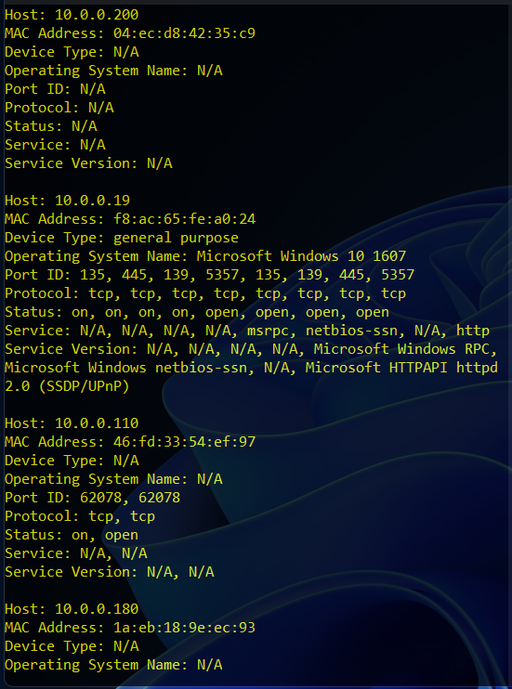
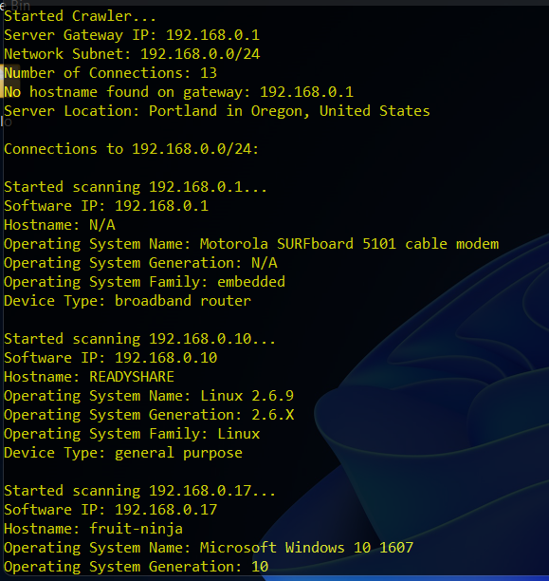
Crawler Agent Demo
Notes:
If there’s anything to show, do it here
This can include existing pages/tools that you’re expanding upon
It could include your UI sketches and descriptions of your project
It could also show off some of the libraries that you’ll be working with
As an alpha, there's multiple ways to approach the demo
At the very least show the parts that you do have working
This can be pulling data, a running database, a web interface that's partially finished
We know it's still early, but you should have something by now…

Slide 11
Demo Time - If you have anything to show jack+artis
If there’s anything to show, do it here
  This can include existing pages/tools that you’re expanding upon
  It could include your UI sketches and descriptions of your project
  It could also show off some of the libraries that you’ll be working with
As an alpha, there's multiple ways to approach the demo
  At the very least show the parts that you do have working
  This can be pulling data, a running database, a web interface that's partially finished
  We know it's still early, but you should have something by now…

Slide 12
Given what you’ve learned, how has the project timeline and planned sprint releases changed?
What are you unsure about? How do you plan to reduce that uncertainty?
Revised Project Release Plan (Jack)
10/24-11/6 | 1/30 - 2/12
11/7 - 11/ 20 | 2/13 - 2/26
11/27 - 12/4 - Post Thanksgiving | 2/27 - 3/10 - Version 0 Complete
12/5 - 12/18 - Layouts + Outlines Done | 3/18 - 3/25 - Post Spring Break
12/19 - 1/1 - Winter Break | 3/26 - 4/8
1/2 - 1/15 - Winter Break | 4/9 - 4/22 - Debug and Optimize Done
1/16 - 1/29 | 4/23 - 5/3 - Delivery and Deployment

Slide 13
Summary
Lots of progress:
  Scanning collects an array of information
  Database is set up, with the Python API complete
  UI has multiple pages built (Login, Home, etc.)
Development flow:
  Teamwork, meetings, development strategies, etc.
Looking forward:
  Clear picture of the future work
  Accomplishable in timeframe
Notes:
[Brandon]
This is a short presentation (target is 15 minutes + 5-8 mins in questions)
Focus on what business objectives you’re now able to confidently address and what notable wins you’ve had through your alpha dev window since the project plan presentation
In summary, we’ve made lots of progress in initial development of each component of the project
Scanning collects an array of information
DB is set up; python api is set up
UI login page built, home page built, and more
We’ve gotten into a flow with teamwork, team meetings, development strategies, etc.
Most importantly, we have a clear picture of the work that needs to be accomplished in the second semester, and believe in our ability to do so

